Slide 1
Retail Rover
A POS System
G2_WD11

Slide 2

Project powered by

Slide 3
Introduction
Methodology
Expected Project Results
Budget
Roles and Responsibilities
Schedule and Progress Tracking

Slide 4
Introduction
Ganesha The Food Store is a mini supermarket located near the outskirts of Colombo 13 .
This supermarket has been providing our residents with food and groceries for a while and is one of the most convenient markets around that area.
The store has an outdated POS system which is difficult to cope up with the current retail demands of the supermarket.
Our goal is to innovate and introduce a much more sophisticated POS system that would be more compatible to the current and future retail demands.

Slide 5
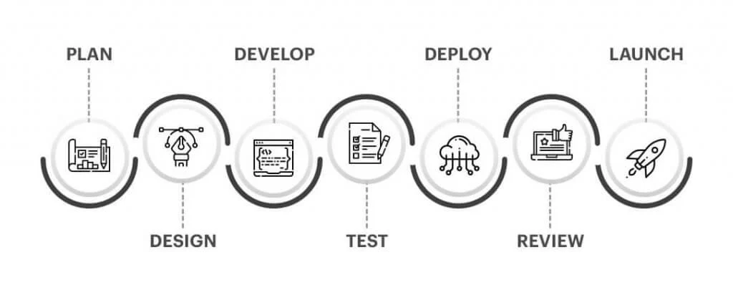
Methodology

Slide 6
Planning | Identifying needs of the client and planning the solutions for the system and sketching the outcome of the project.
Analysis of concepts | Analyzing software by taking a deeper look on the problems to prepare the budget.
Designing | Front end , Back end and database development
Implementation | Developing small portions of a project at a time
Testing | Ensuring quality of the implemented software
Deployment | Installing and Configuring the system on the designated hardware

Slide 7
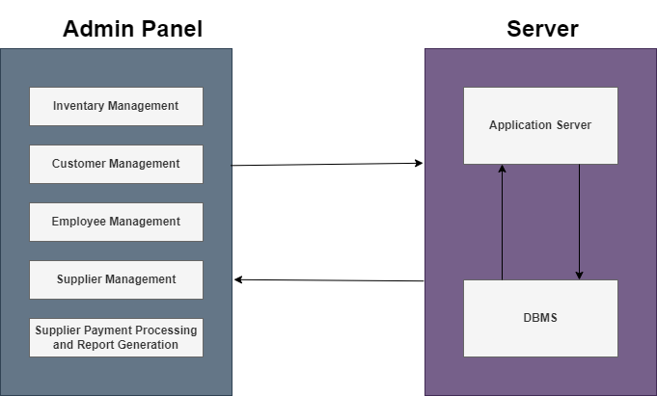
High level architecture

Slide 8
Expected Project Results
A new fresh UI will be designed and implemented.
POS Software with E-Bill features added.
A drop-down menu allows you to choose different prices for single barcode
Documentation intended for administrators and user

Slide 9
Function Distribution
SA22446626 – G.Kavinesh | Inventory Management
Sa22447098- V.Thujithra | Customer management
SA22448088- K.Diluksha | Employee management
SA22493606 – P.Manav Pranavin | Supplier Management
SA22494078- S.Vickash | Supplier Payment process and report generation

Slide 10
Budget
Phase | Estimated Cost
Personal Costs
Software Developer | $200
UI/UX Designer | $225
Project Manager | $270
Marketing | $120
Technology and Infrastructure
Admin Dashboard | $110
SSL Certificate | N/A
Payment Gateway Setup | $100
Maintenance
Regular Maintenance | $120
Improvements | $100
Security Measures | $75
Content Creation
Product Details | $300
Graphics and Visual Assets | $250
 | Total Cost | $1870

Slide 11
Roles and Responsibilities
SA22447098- V Thujithra | Facilitate Agile processes and remove impediments to the team’s progress and facilitate effective collaboration
SA22448088 – K Diluksha | Designing UI/UX for the POS system . Collaborate with the development team to align design with user needs
SA22494078 – S Vickash | Design , develop and test features for the POS system . Collaborate with other members and understand requirements
SA22493606 – P Manav | Develop and execute test plans to ensure the quality of the POS system and collaborate with team to identify defects
SA22446626 – G Kavinesh | Act as the primary point of contact between the stakeholders and the development team.

Slide 12
Schedule and Progress Tracking
Initiation (Week 1) | 12/02/24 – 16/02/2024
Planning (Week 2) | 16/02/2024 – 21/02/2024
Design Phase (Week 4-6) | 23/02/2024 – 05/03/2024
Development Phase (Week 5-9) | 29/02/2024 – 26/03/2024
Quality Assurance (Week 9-10) | 26/03/2024 – 04/04/2024
Deployment ( Week 11-12) | 05/04/2024 – 08/04/2024
Training and Documentation ( Week 12-14) | 08/04/2024 – 20/04/2024
Post-Implementation Review (Week 14-15) | 21/04/2024 – 30/03/2024

Slide 13
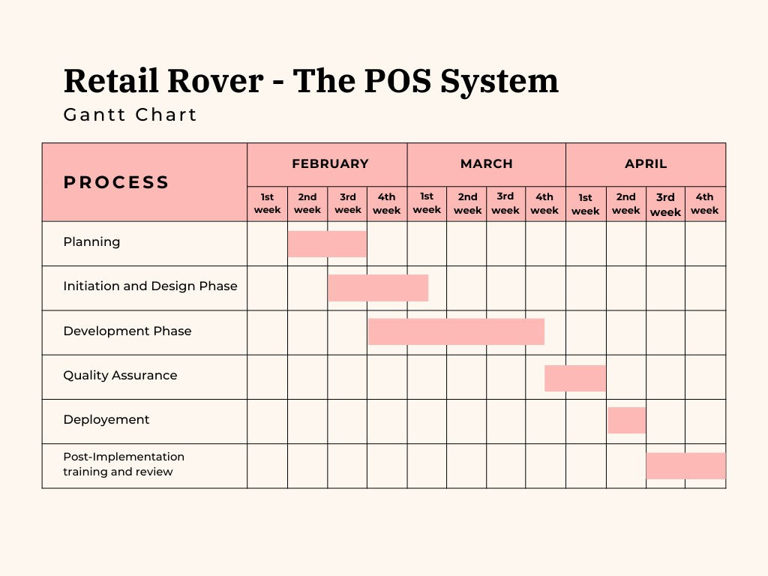
Gantt Chart

Slide 14


Slide 15
Thank you !

